Slide 1

Mobile Application Development
U. V. Patel College of Engineering, Ganpat University

Slide 2
USER INTERFACE
Designing
with
LAYOUTS

Slide 3
What is an XML Layout?
“ An XML-based layout is a specification of the various UI components (widgets) and the relationships to each other
–and to their containers – all written in XML format.”

Slide 4
XML Layouts /Containers
1.LinearLayout (the box model), 2.RelativeLayout (a rule-based model), and 3.TableLayout (the grid model), along with 4.ScrollView, a container designed to assist
with implementing scrolling containers.
5. Other(ListView, GridView, WebView, MapView,…)
6. constraints Layout.

Slide 5
1. Linear Layout
LinearLayout is a box model – widgets or child containers are lined up in a column or row, one after the next.

Slide 6
Configure a LinearLayout
container's contents 5 areas to be configure
orientation,
fill model,
weight,
gravity,
padding ,
margin

Slide 7
Orientation
indicates whether the LinearLayout represents a row or a column.
Add the android:orientation property to your LinearLayout element in your XML
layout, setting the value to be horizontal
for a row or vertical for a column.
The orientation can be modified at runtime by invoking setOrientation()

Slide 8
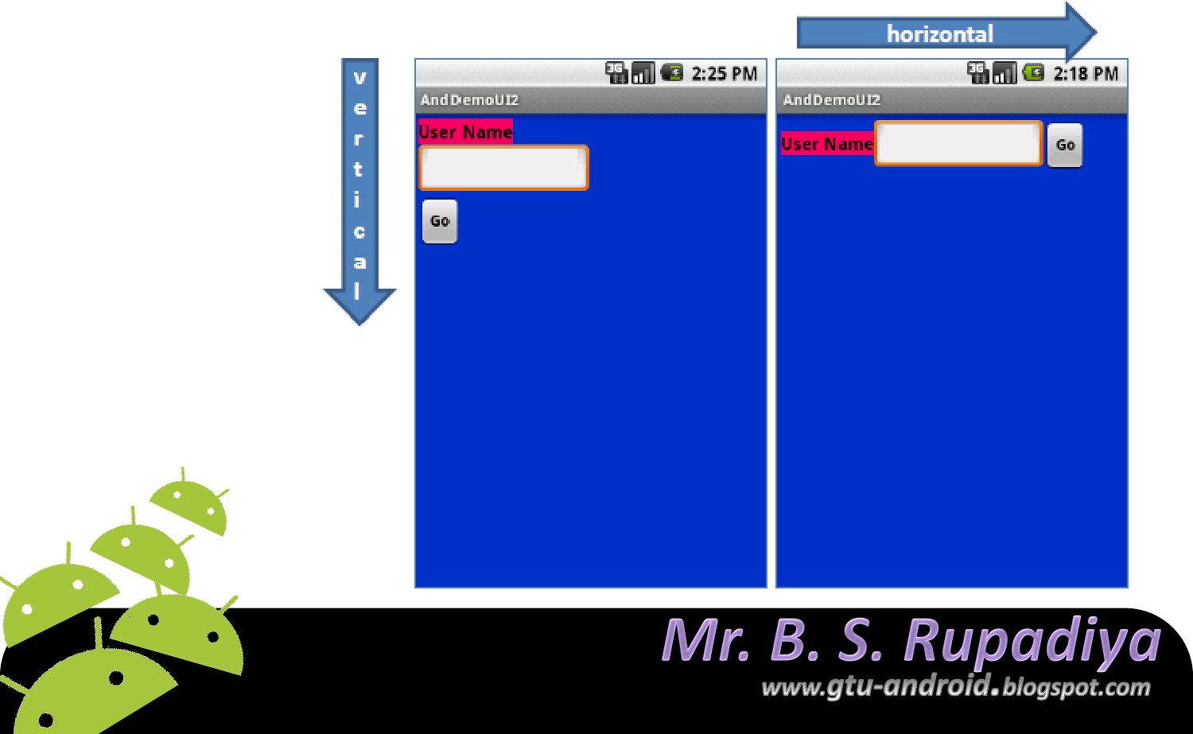
Orientation indicates whether the LinearLayout represents a row(HORIZONTAL) or a column (VERTICAL).
android:orientation=" horizon tal"

Slide 9
Linear Layout: Fill Model
All widgets inside a LinearLayout must supply dimensional attributes android:layout_width and android:layout_height
to help address the issue of empty space. Values used in defining height and width are:
Specific a particular dimension, such as 125dip (device independent pixels)
Provide wrap_content, which means the widget should fill up its natural space, unless that is too big, in which case Android can use word-wrap as needed to make it fit.
Provide fill_parent, which means the widget should fill up all available space in its enclosing container, after all other widgets are taken care of.
12

Slide 10
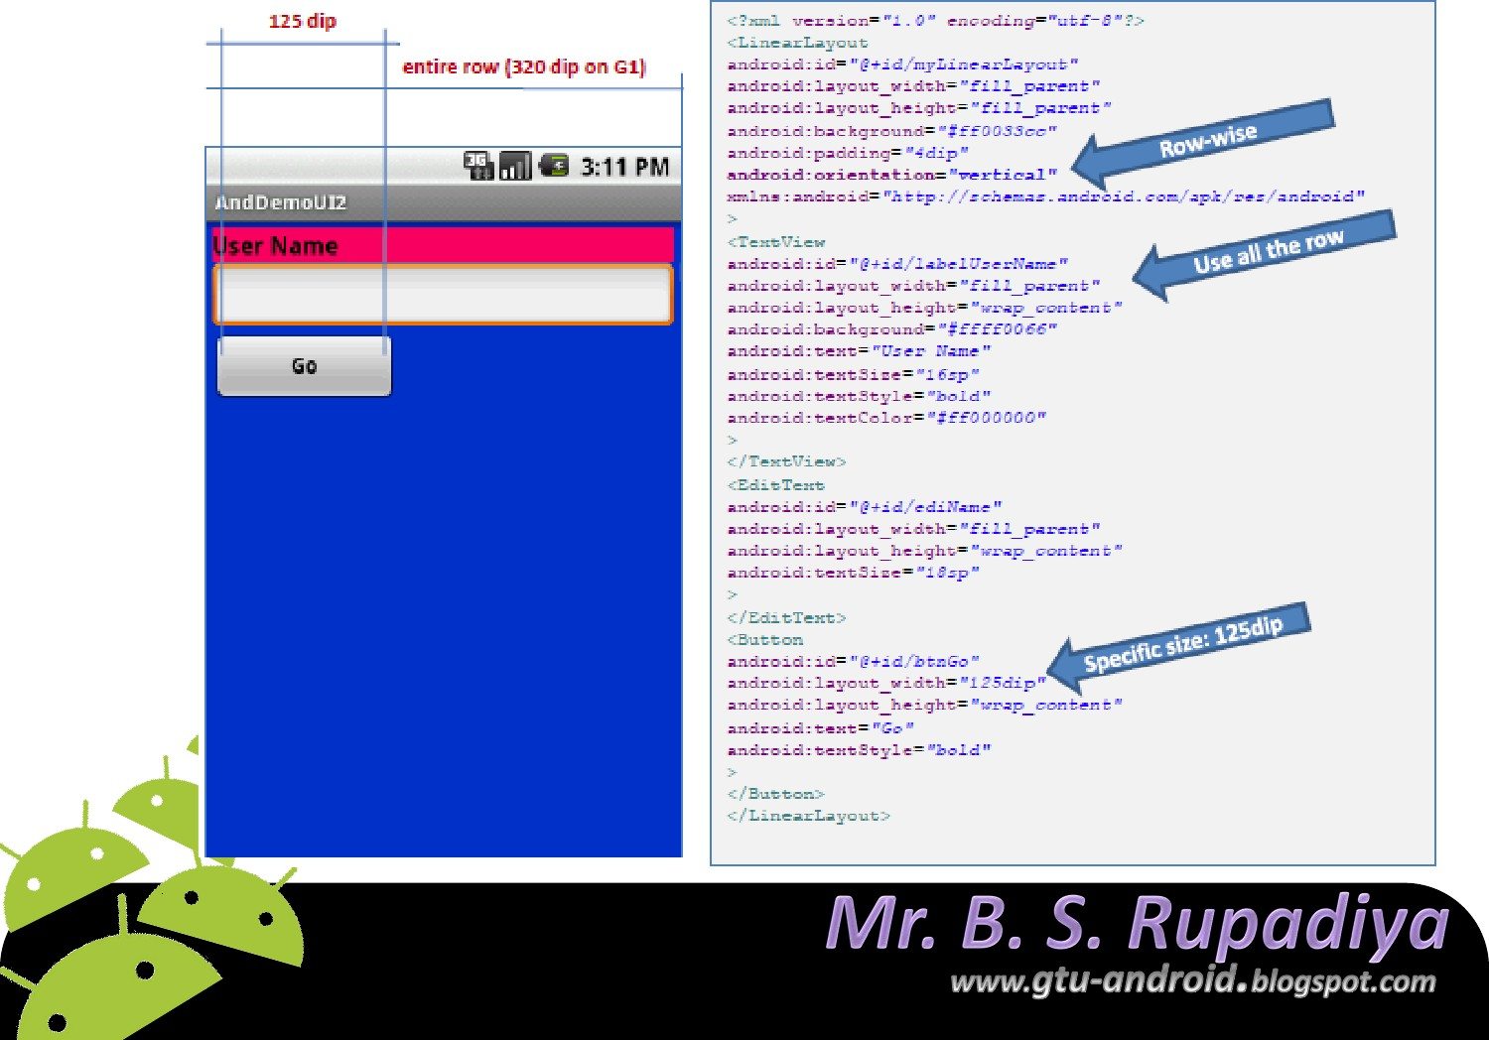
G1
phone res olution is: 320x 480
dip (3.2in).
13

Slide 11
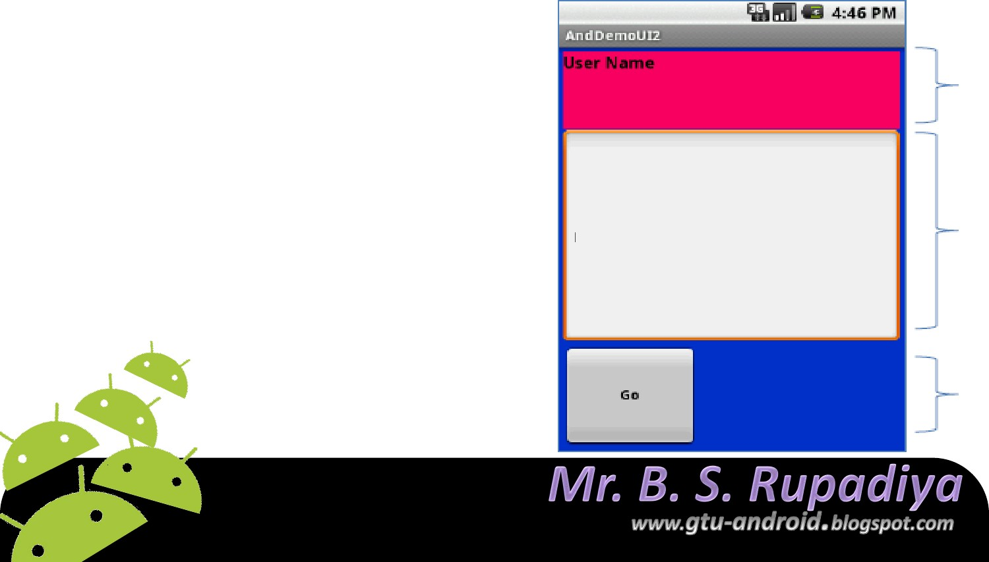
It is used to proportionally assign space to widgets in a view.
You set android:layout_weight to a value (1, 2, 3, …) to indicates what proportion of the free space should go to that widget.
Example
Both the TextView and the Button widgets have been set as in the previous example. Both have the additional property
1
android:layout_weight ="1―
2
whereas the EditText control has
android:layout_weight ="2―
1
Default value is 0
14

Slide 12
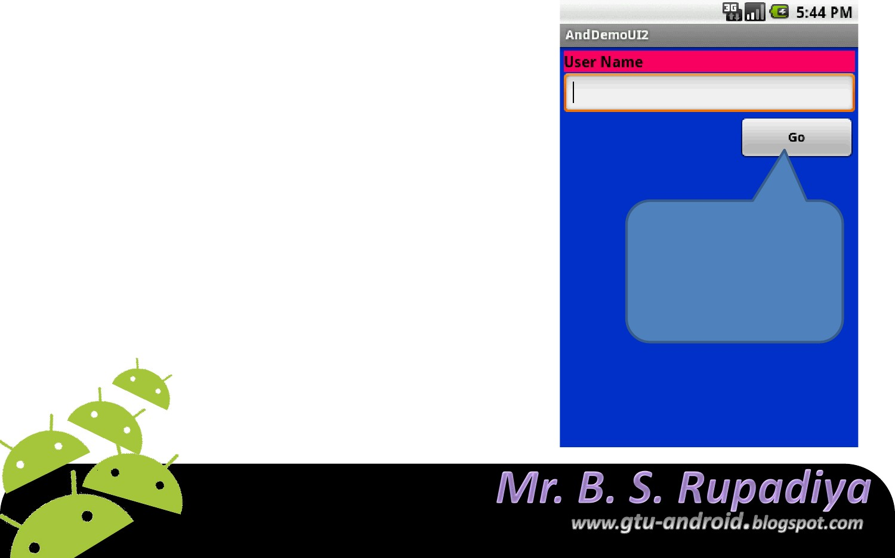
Linear Layout: Gravity
It is used to indicate how a control will align on the screen.
By default, widgets are left-and top- aligned.
You may use the XML property
android:layout_gravity=“…”
to set other possible arrangements: left, center, right, top, bottom, etc.
Button has right gravity
15

Slide 13
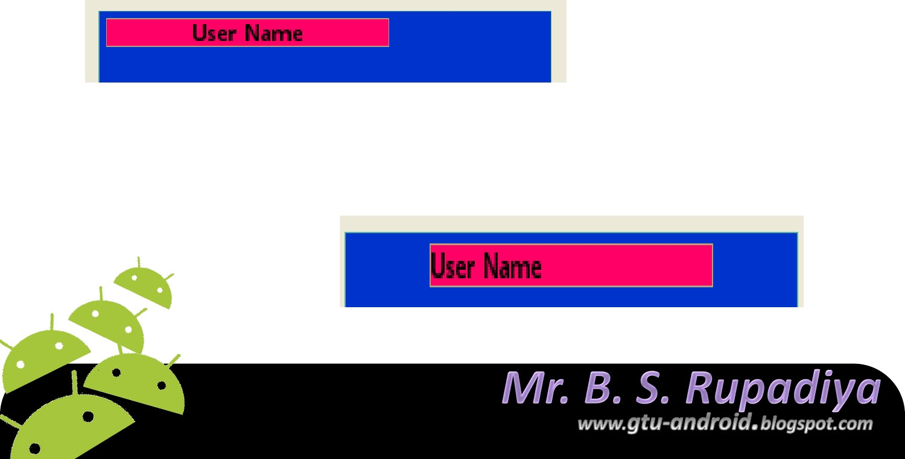
gravity vs. layout_gravity
android:gravity
specifies how to place the content of an object, both on the x-and y-axis, within the object itself.
android:gravity="center"
android:layout_gravity
positions the view with respect to its parent (i.e. what the view is contained in).
android:layout_gravity=“center”
16

Slide 14
Linear Layout: Padding
The padding specifies how much space there is between the boundaries of the widget's "cell" and the actual widget contents.
If you want to increase the internal whitespace between the edges of the and its contents, you will want to use the:
android:padding property
or by calling setPadding() at runtime on the widget's Java object.
17

Slide 15
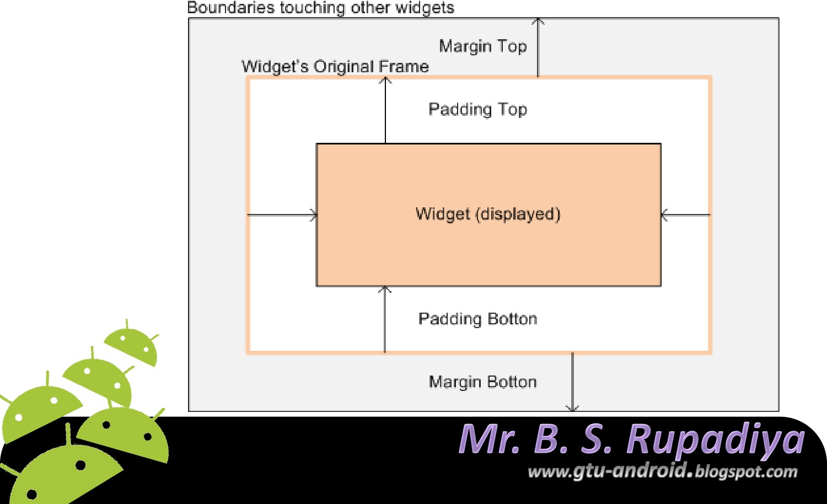
Linear Layout: Padding and Margin
18

Slide 16
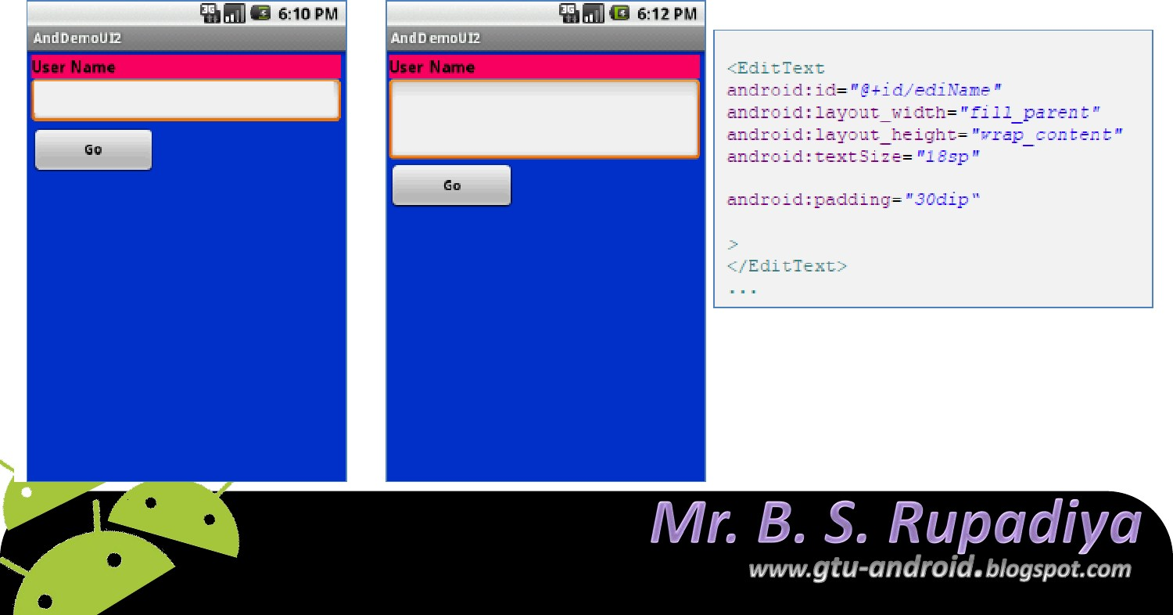
Linear Layout: Internal Margins Using Padding
Example:
The EditText box has been changed to display 30dip of padding all around
Bipin Rupadiya
19

Slide 17
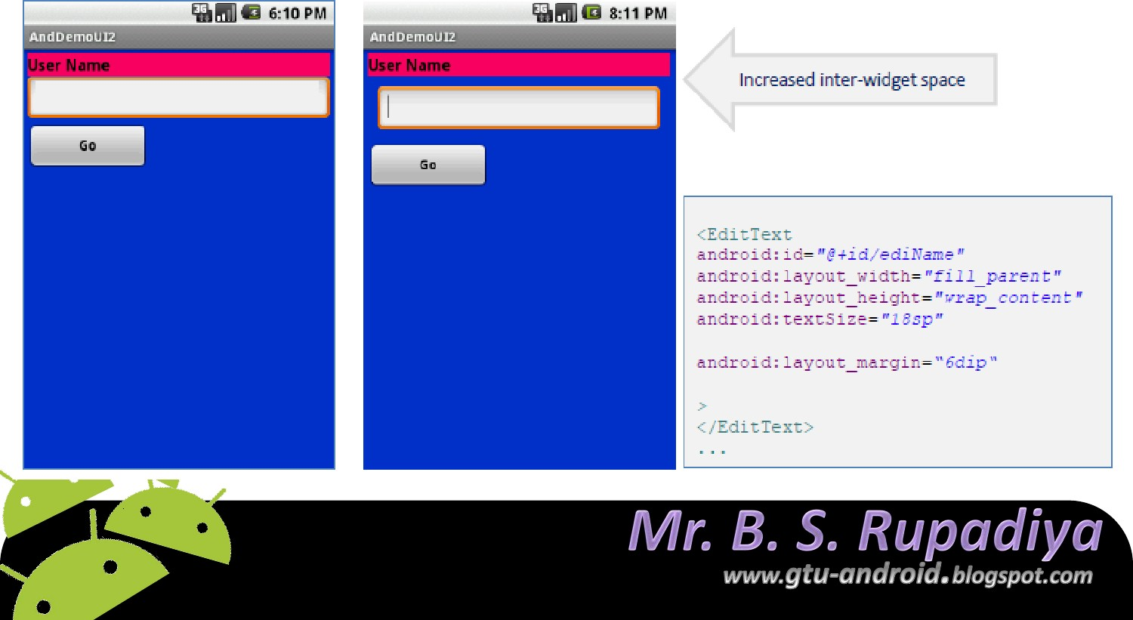
Linear Layout: (External) Marging
By default, widgets are tightly packed next to each other.
To increase space between them use the android:layout_marginattribute
20

Slide 18
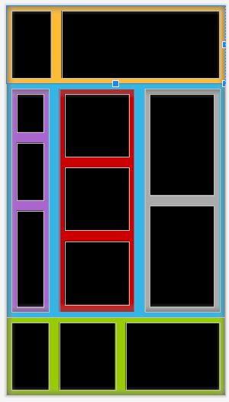
Linear Layout Example:

Slide 19
Constraint Layout

Slide 20
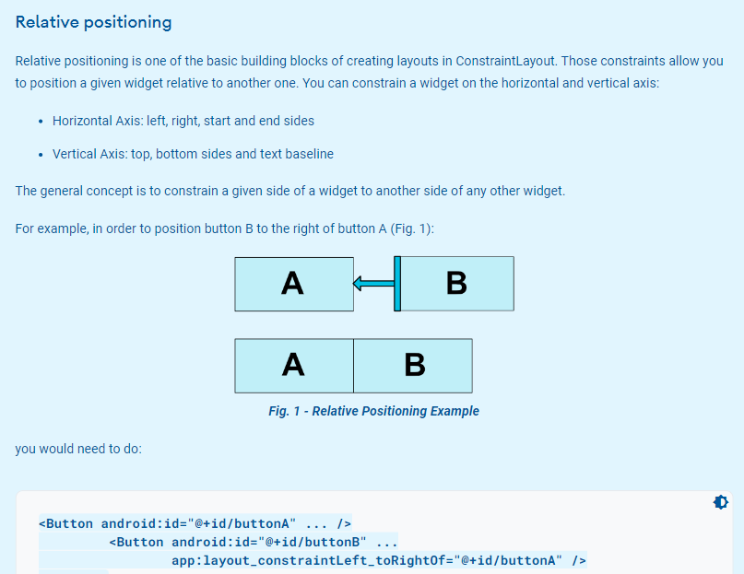
Constraint Layout

Slide 21
Constraint Layout
Important Note: To define a view’s position in Constraint Layout, you must add at least one horizontal and one vertical constraint to the view. Each constraint defines the view’s position along either the vertical or horizontal axis; so each view must have a minimum of one constraint for each axis, but often more are necessary. There are several types of restrictions.

Slide 22
Constraint Layout
In particular, the following are some of the restrictions that can be used to set a position relative to another item:
layout_constraintStart_toStartOf : the left border of the element is positioned relative to the left border of another element
layout_constraintStart_toEndOf : the left border of the element is positioned relative to the right border of another element
layout_constraintEnd_toStartOf: the right border of the element is positioned relative to the left border of another element
layout_constraintEnd_toEndOf: the right border of the element is positioned relative to the right border of another element.

Slide 23
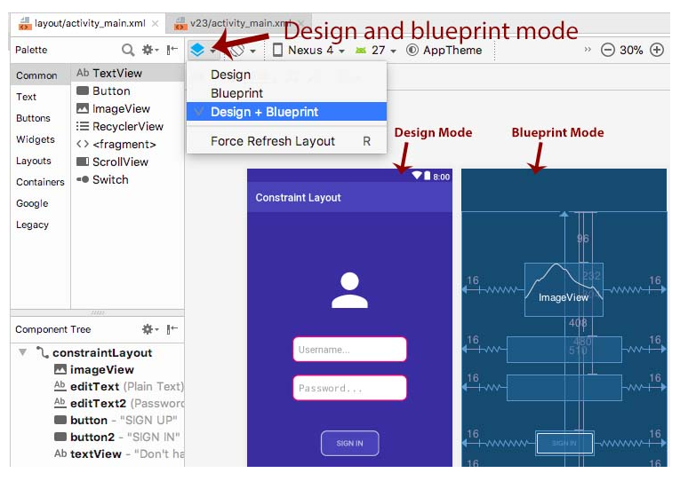
Constraint Layout

Slide 24
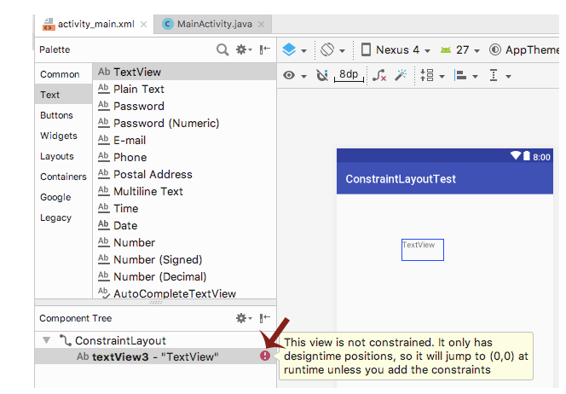
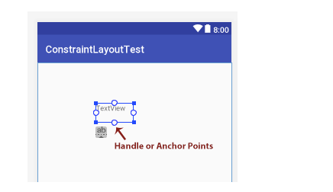
Constraint Layout

Slide 25
Constraint Layout

Slide 26
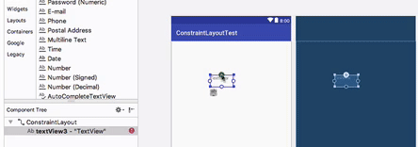
Constraint Layout
You will need to make at least two connection of handles with something else to make it Constrained. So this way you can create Constrained.

Slide 27
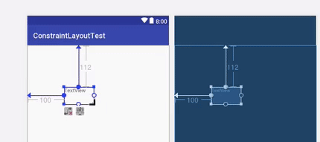
Constraint Layout
You will need to make at least two connection of handles with something else to make it Constrained. So this way you can create Constrained.

Slide 28
Constraint Layout
You will need to make at least two connection of handles with something else to make it Constrained. So this way you can create Constrained.

Slide 29
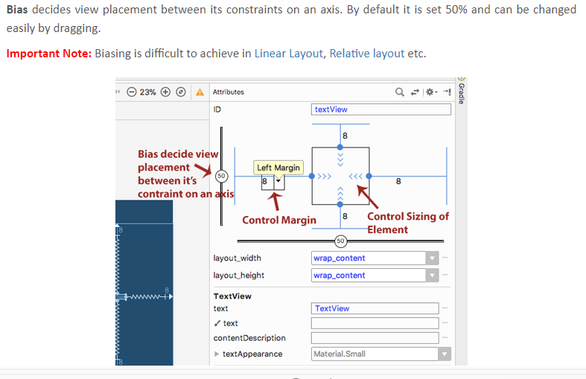
Constraint Layout

Slide 30
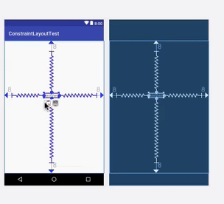
Delete Constraint Layout

Slide 31
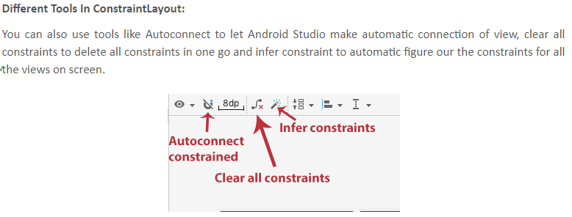
Constraint Layout

Slide 32
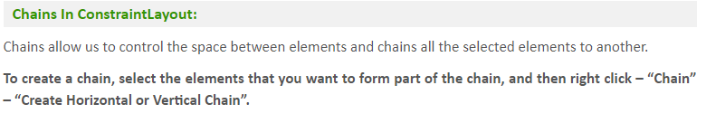
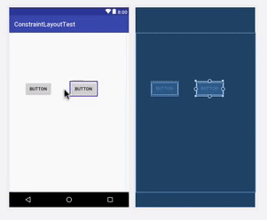
Constraint Layout

Slide 33
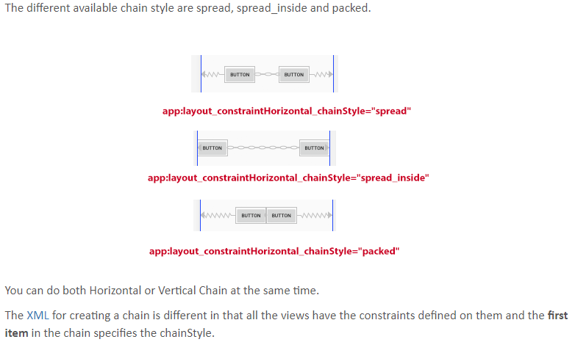
Constraint Layout

Slide 34
Table Layout

Slide 35
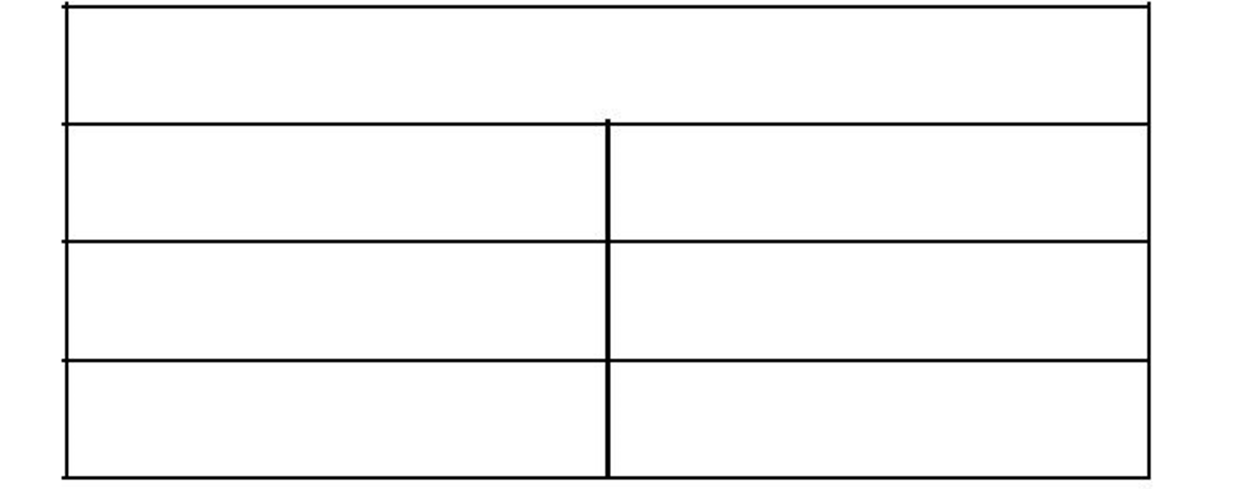
Table Layout
Android's TableLayout allows you to position your widgets in a grid made of identifiable rows and columns.
Columns might shrink or stretch to accommodate their contents.
TableLayout works in conjunction with TableRow.
TableLayout controls the overall behavior of the container, with the widgets themselves positioned into one or more TableRow containers, one per row in the grid.

Slide 36
Android TableLayout does't support row span, but similer functionality can be achieved using nested TableLayout.

Slide 37
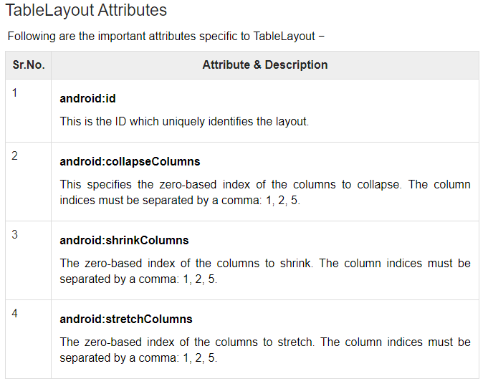

Slide 38
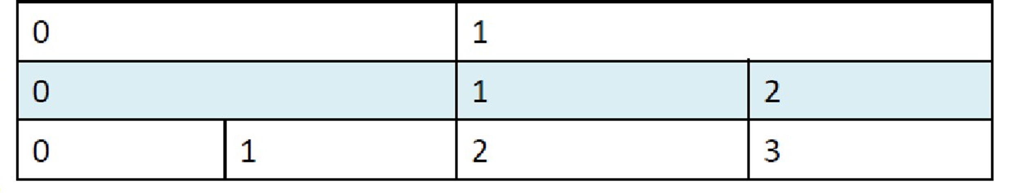
TableRow
Rows are declared by you by putting widgets as children of a TableRow inside the overall TableLayout.
The number of columns is determined by Android .
So if you have three rows, one with two widgets, one with three widgets, and one with four widgets, there will be at least four columns.

Slide 39
column
a single widget can take up more than one column by including the android:layout_span property, indicating the number of columns the widget spans
<TableRow>
<TextViewandroid:text="URL:" />
<EditText android:id="@+id/entry― android:layout_span="3" />
</TableRow>
we can control the number of columns in an indirect way using span which is similar to HTML Table tag

Slide 40
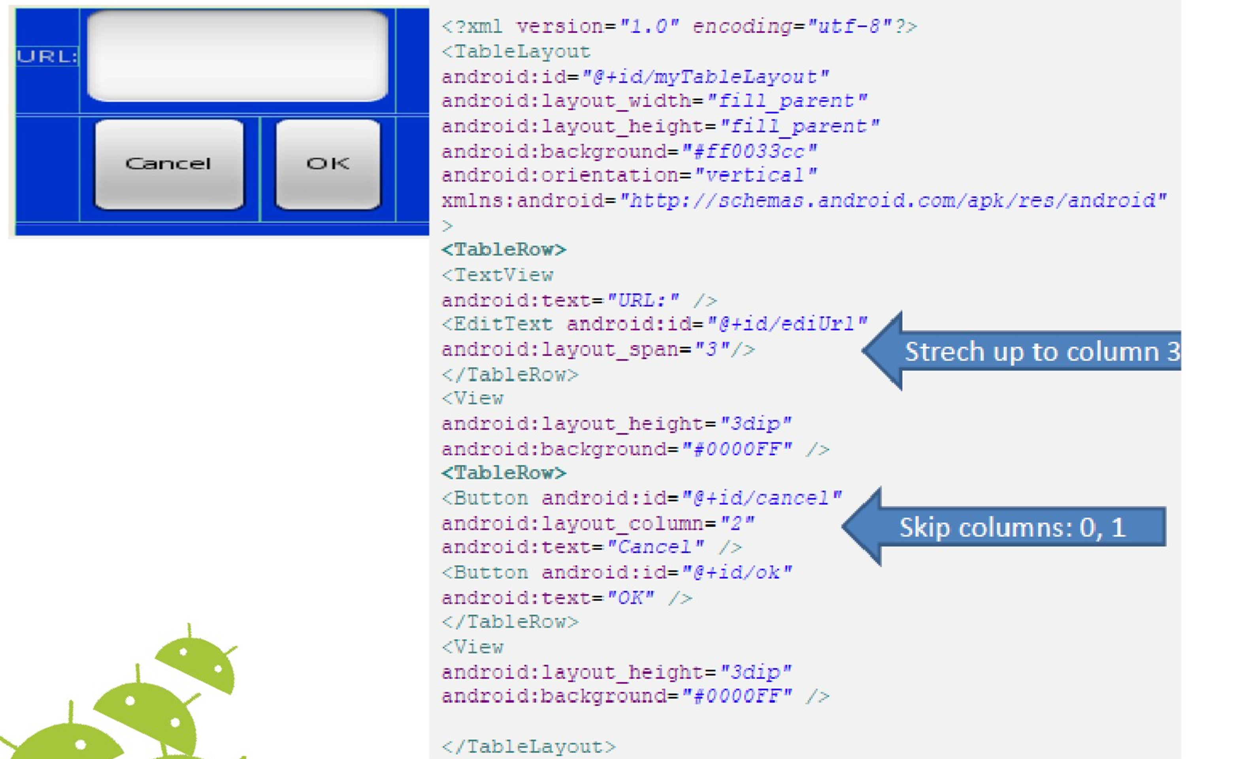
33

Slide 41
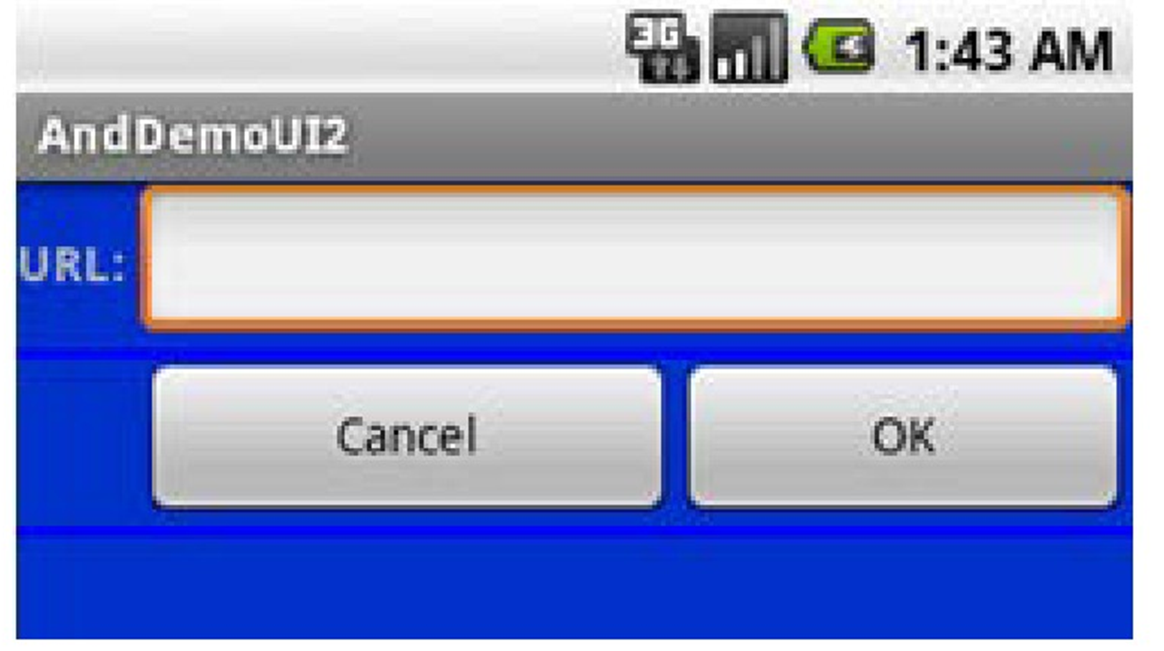
By default, each column will be sized according to the "natural" size of the widest widget in that column
android:stretchColumns=―…‖
android:stretchColumns="2,3,4"
34

Slide 42
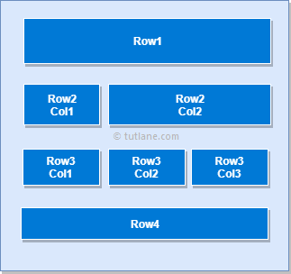
Exercise

Slide 43
ScrollView Layout
When we have more data than what can be shown on a single screen you may use the ScrollView control.
It provides a scrolling access to the data. This way the user can only see part of your layout at one time, but the rest is available via scrolling.
This is similar to browsing a large web page that forces the user to scroll up the page to see the bottom part of the form.
35

Slide 44
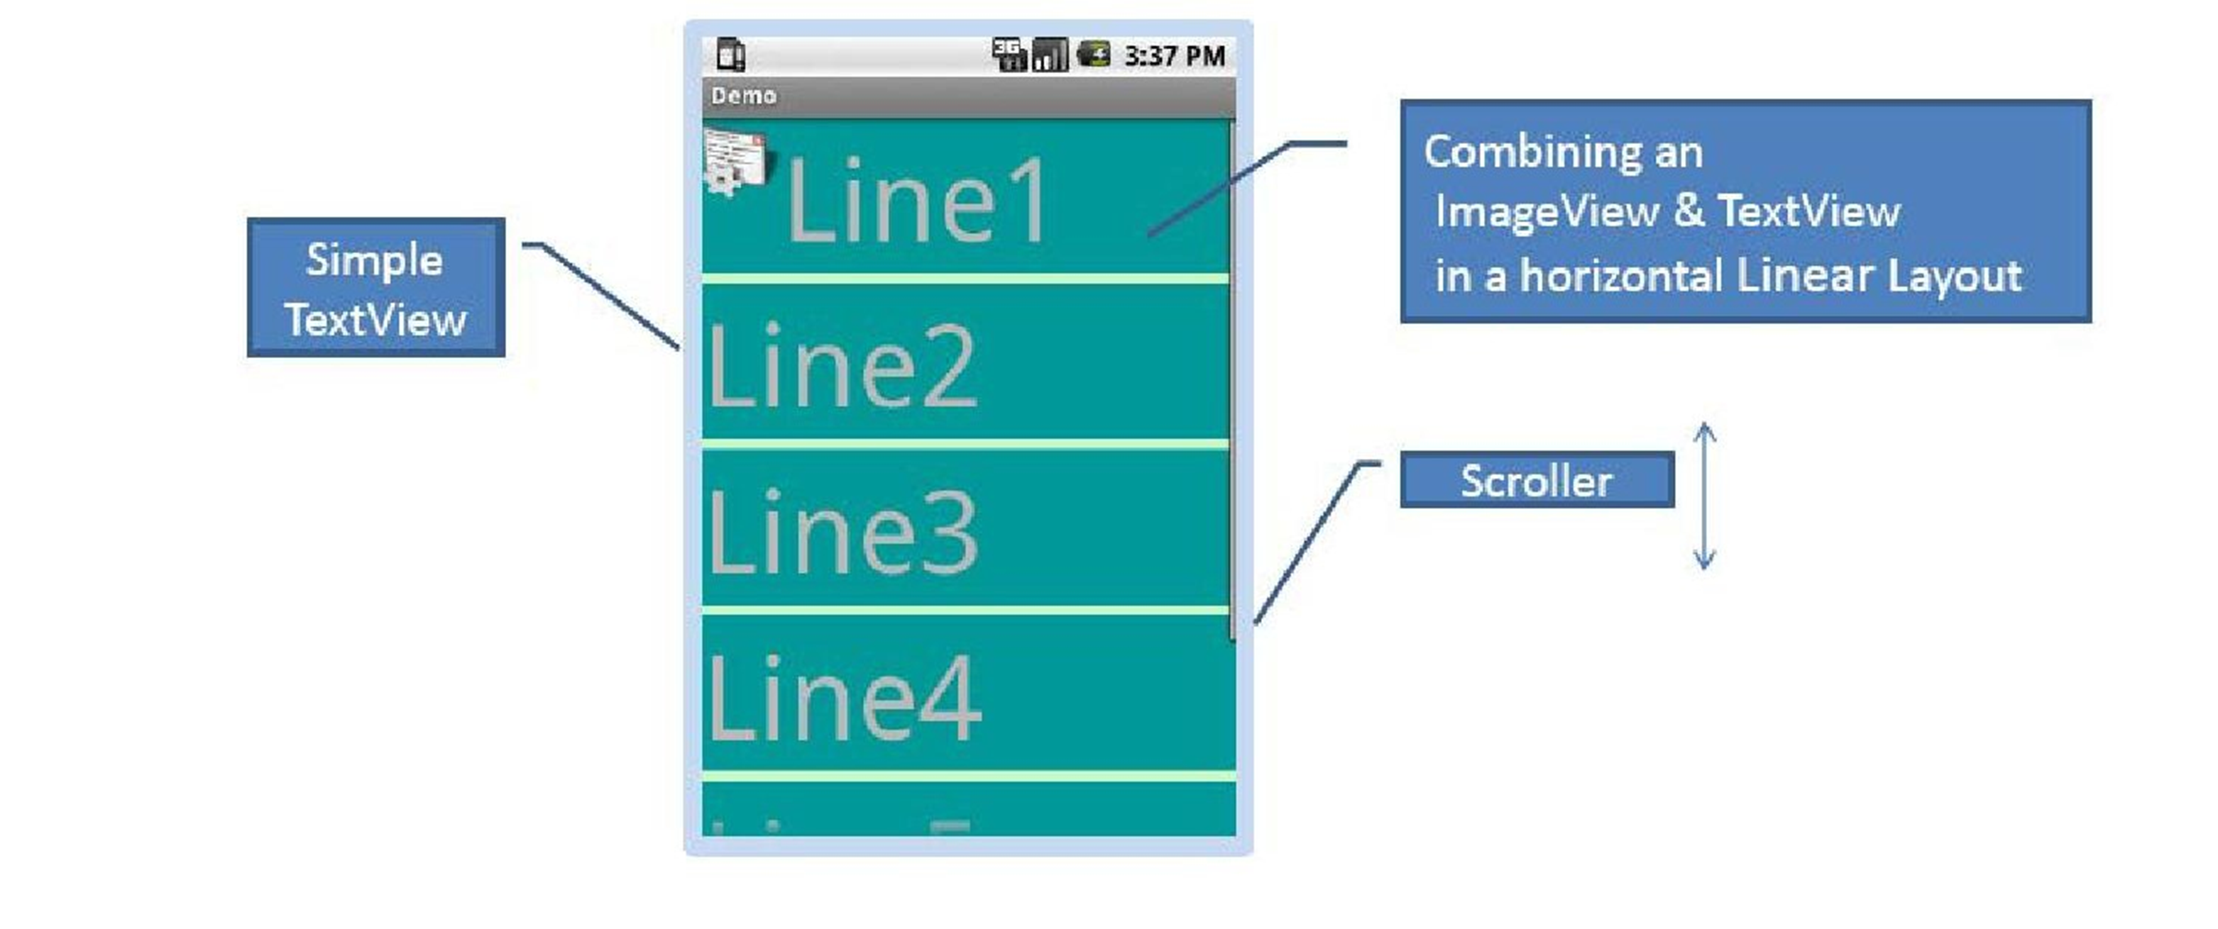
Example
36

Slide 45
<?xmlversion="1.0"encoding="utf-8"?>
<ScrollView android:id="@+id/myScrollView1" android:layout_width="fill_parent" android:layout_height="fill_parent" android:background="#ff009999"
xmlns:android="http://schemas.android.com/apk/res/android"
>
<LinearLayout android:id="@+id/myLinearLayoutVertical" android:layout_width="fill_parent" android:layout_height="fill_parent" android:orientation="vertical"
>
<LinearLayout android:id="@+id/myLinearLayoutHorizontal1" android:layout_width="fill_parent" android:layout_height="fill_parent" android:orientation="horizontal"
>

Slide 46
<ImageView android:id="@+id/myPicture" android:layout_width="wrap_content" android:layout_height="wrap_content" android:src="@drawable/icon"/>
<TextView android:id="@+id/textView1" android:layout_width="fill_parent" android:layout_height="wrap_content" android:text="Line1" android:textSize="70dip"/>
</LinearLayout>
<View android:layout_width="fill_parent" android:layout_height="6dip" android:background="#ffccffcc"/>
<TextView android:id="@+id/textView2" android:layout_width="fill_parent" android:layout_height="wrap_content" android:text="Line2" android:textSize="70dip"/>
<View android:layout_width="fill_parent" android:layout_height="6dip" android:background="#ffccffcc"/>
<TextView android:id="@+id/textView3" android:layout_width="fill_parent" android:layout_height="wrap_content" android:text="Line3" android:textSize="70dip"/>

Slide 47
<View android:layout_width="fill_parent" android:layout_height="6dip" android:background="#ffccffcc"/>
<TextView android:id="@+id/textView4" android:layout_width="fill_parent" android:layout_height="wrap_content" android:text="Line4" android:textSize="70dip"/>
<View android:layout_width="fill_parent" android:layout_height="6dip" android:background="#ffccffcc"/>
<TextView android:id="@+id/textView5" android:layout_width="fill_parent" android:layout_height="wrap_content" android:text="Line5" android:textSize="70dip"/>
</LinearLayout>
</ScrollView>

Slide 48
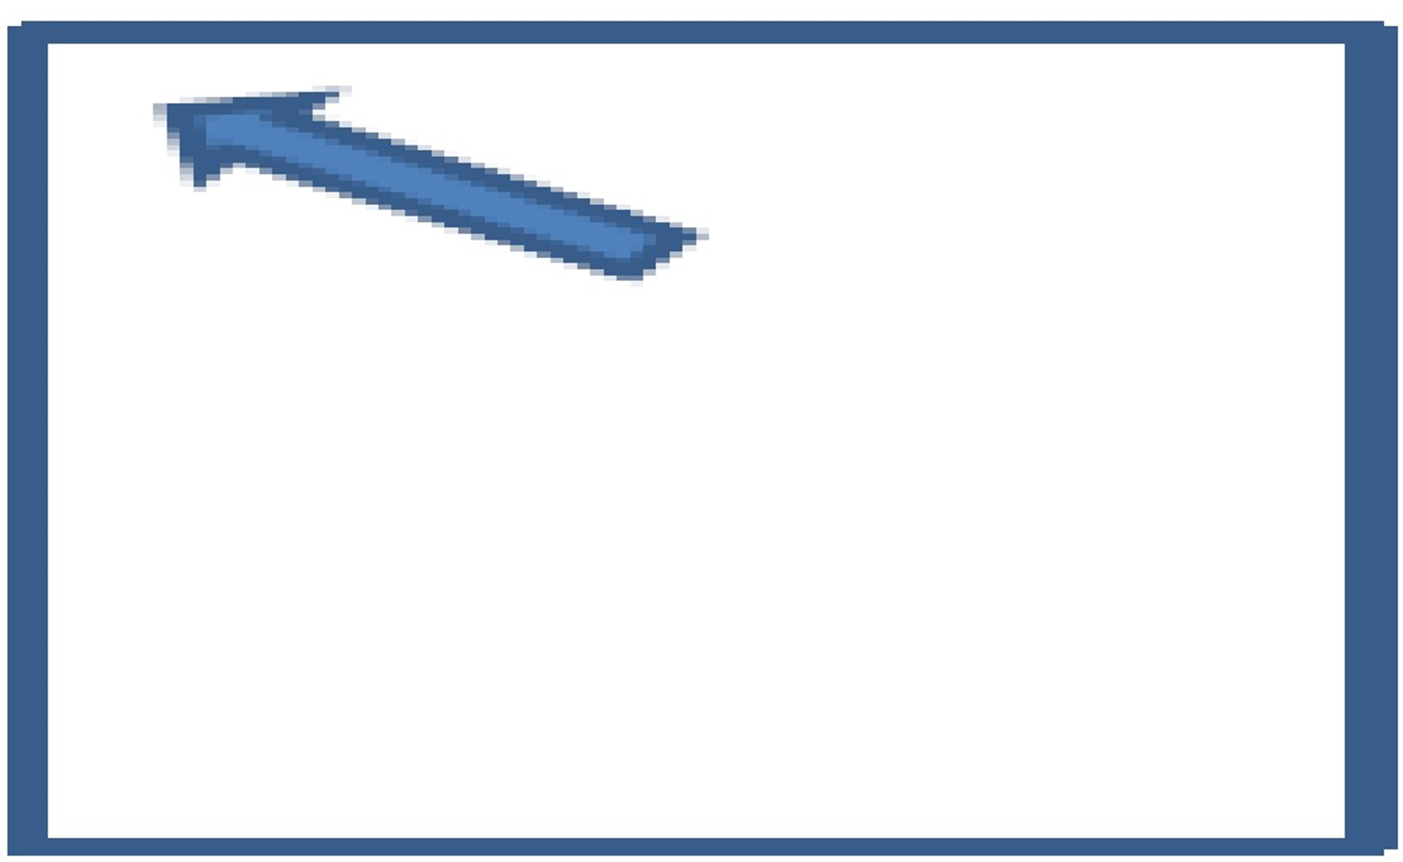
FrameLayout
FrameLayout is the simplest type of layout object. It's basically a blank space on your screen that you can later fill with a single object —for example, a picture that you will swap in and out.
42

Slide 49
Android‘s simplest layout manager is called:
Frame Layout.
All child elements of the FrameLayout are pinned to the top left corner of the screen; you cannot specify a different location for a child view.
Adding multiple views to a frame layout just stacks one on top of the other (overlapping the views)
Subsequent child views will simply be drawn over previous ones, partially or totally obscuring them (unless the newer object is transparent).

Slide 50
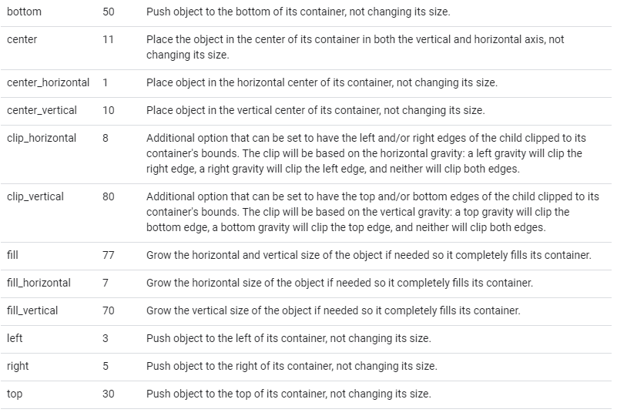
FrameLayout
android:foregroundGravity: The gravity defaults to fill.
Must be one or more (separated by '|') of the following constant values.
42

Slide 51
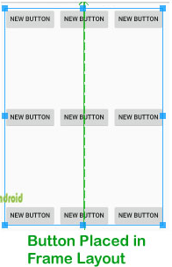
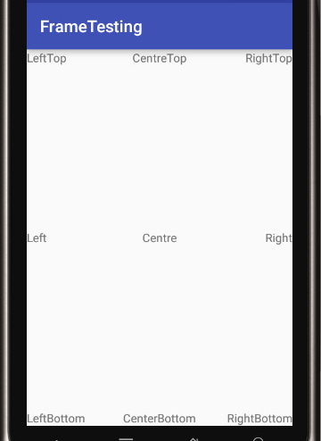

Slide 52
User Interface Screen elements

Slide 53
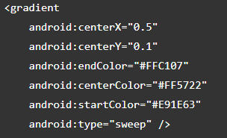



Gradient
Linear Style
Radial Style
Sweep Style

Slide 54
The View Class
The Viewclass represents the basic building block for user interface components
A View occupies a rectangular area on the screen and is responsible for drawing and
event handling.
View is the base class for widgets, which are used to create interactive UI components (buttons, text fields, etc.).

Slide 55
Using Views
View Can be created by
Java Code
Specifying a tree of views in one or more XML layout files

Slide 56
Common operations of View
Set properties: for example setting the text of a TextView. Properties that are known at build time can be set in the XML layout files.
Set focus: The framework will handled moving focus in response to user input. To force focus to a specific view, call requestFocus().

Slide 57
Control View
Material Card View vs android card view
TextInput Layout & TextInput EditText
Rounded Rectangle/oval shapes in xml file
ImageView
Button
How to add vector assets

Slide 58
Basic Widgets

Slide 59
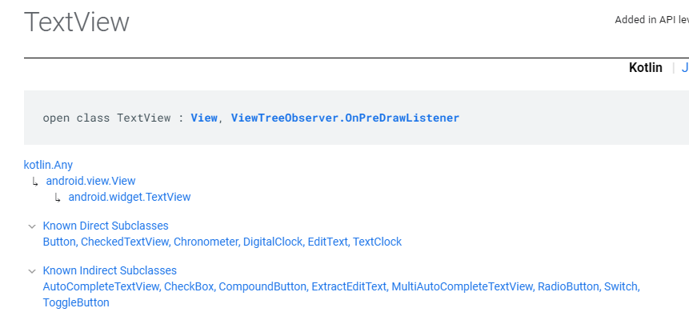
Basic Widgets
Text View:

Slide 60
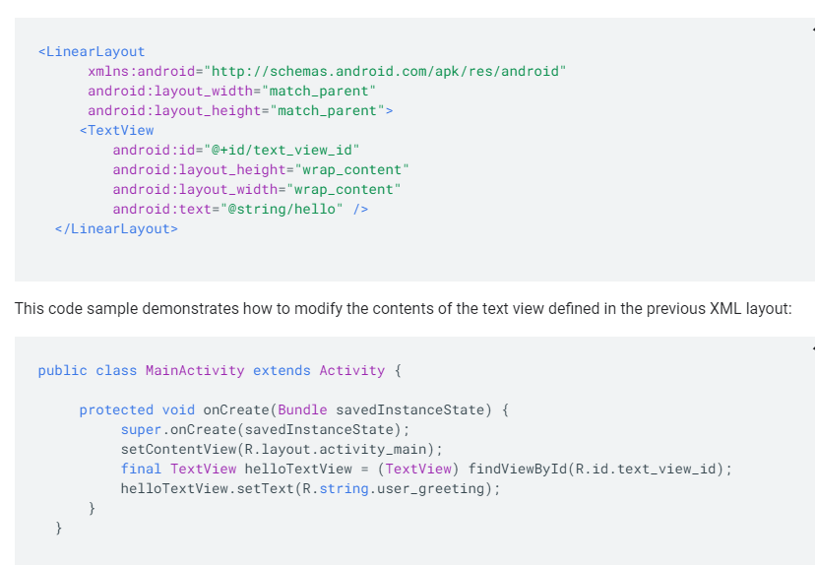
Basic Widgets
Text View:

Slide 61
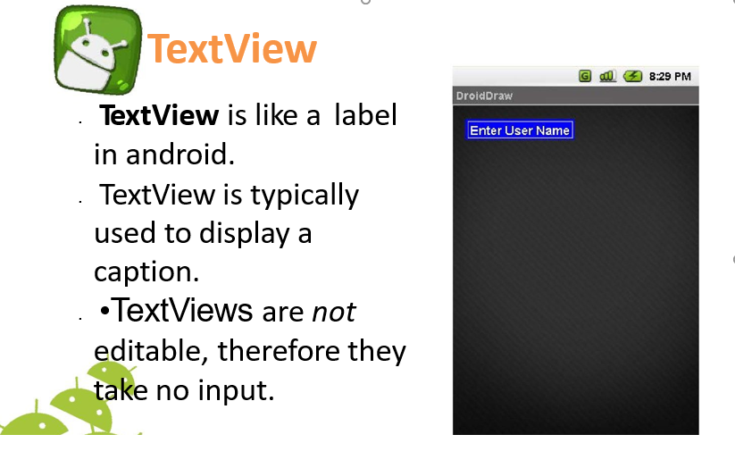
Basic Widgets
Text View:

Slide 62
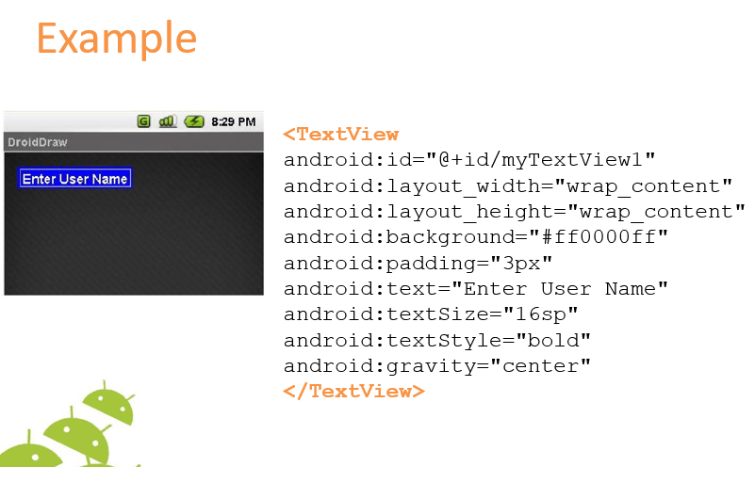
Basic Widgets
Text View:

Slide 63
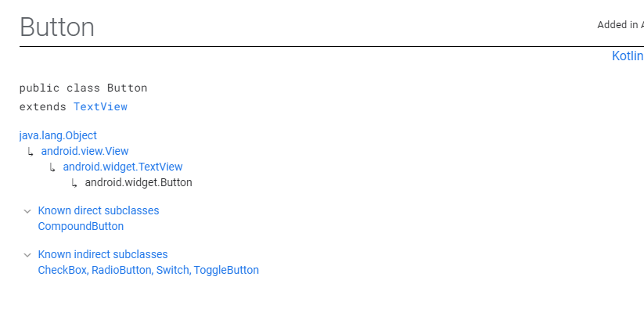
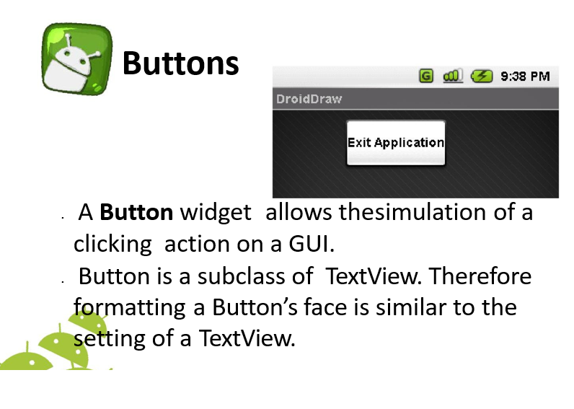
Basic Widgets
Button:

Slide 64
Basic Widgets
Button:

Slide 65
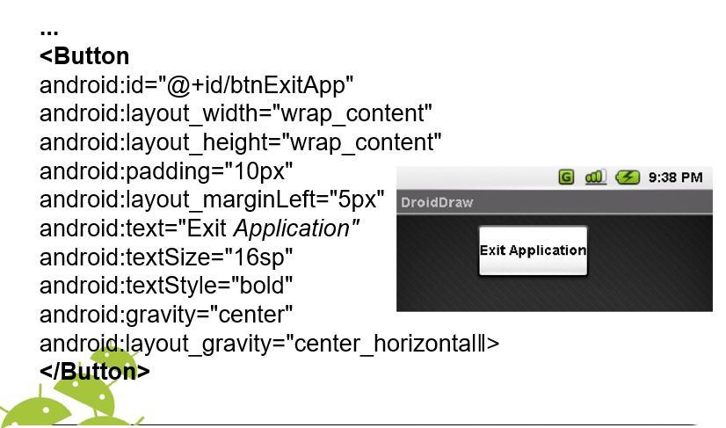
Basic Widgets
Button:

Slide 66
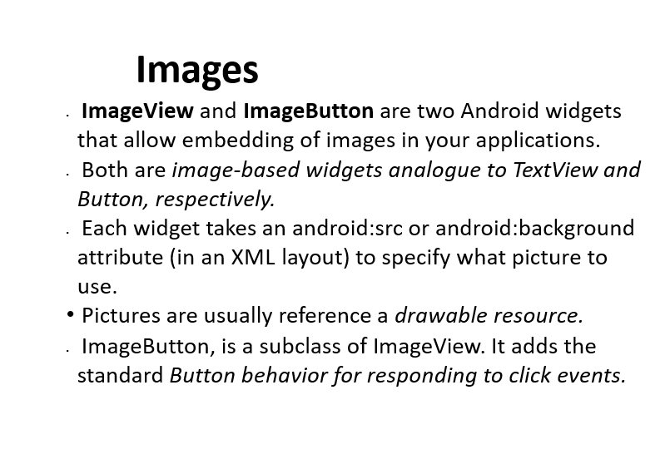
Basic Widgets
Image View and Image Button:

Slide 67
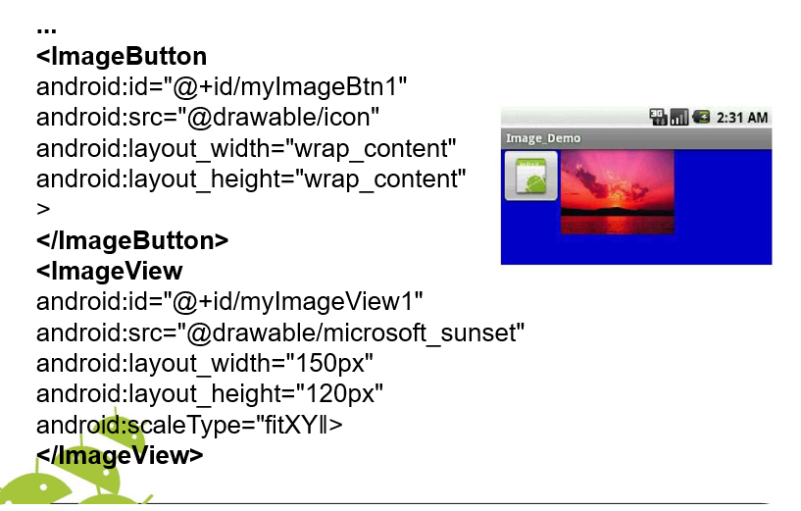
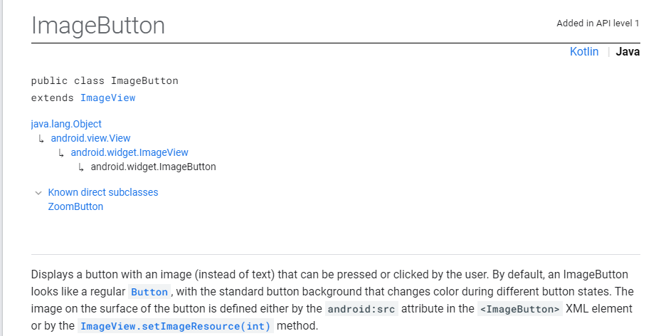
Basic Widgets
Image View and Image Button:

Slide 68
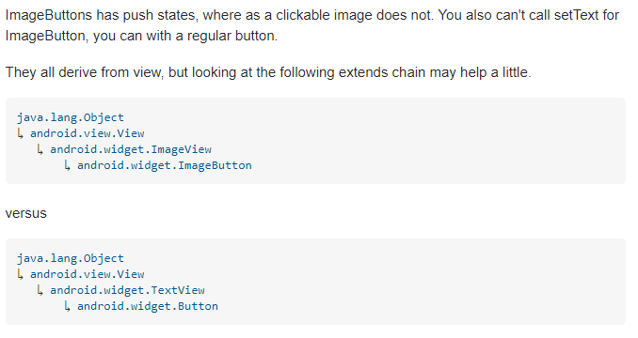
Basic Widgets
Image View and Image Button:

Slide 69
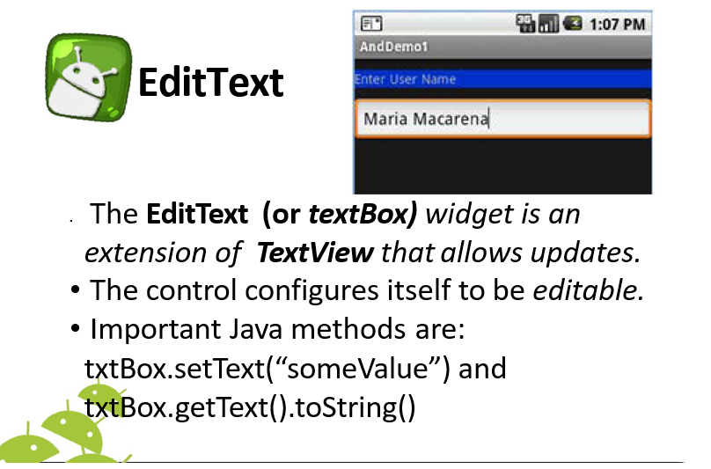
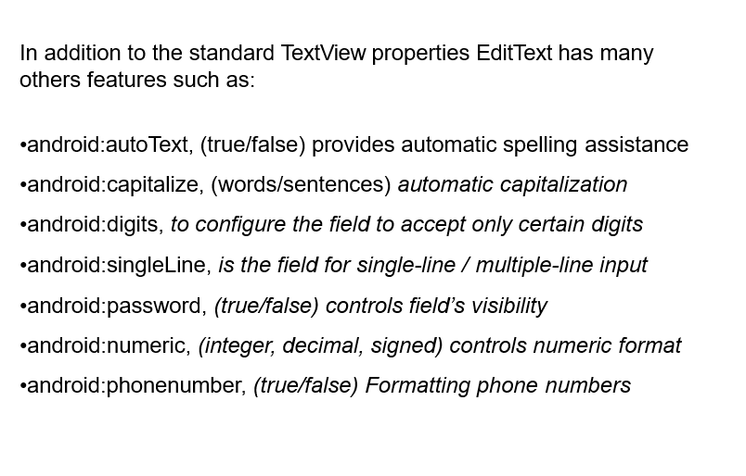
Basic Widgets
Edit Text:

Slide 70
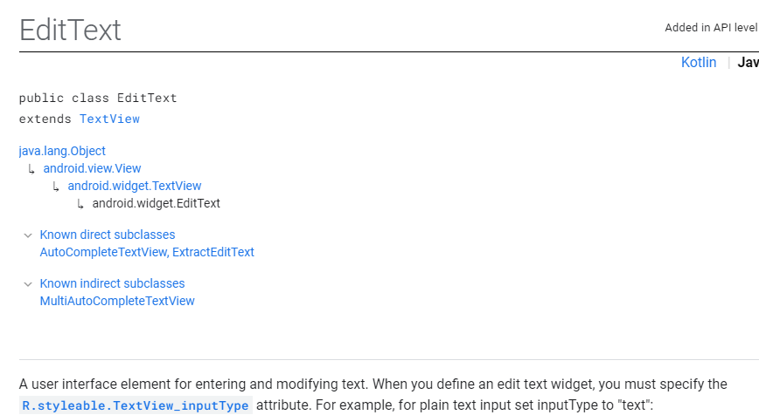
Basic Widgets
Edit text:

Slide 71
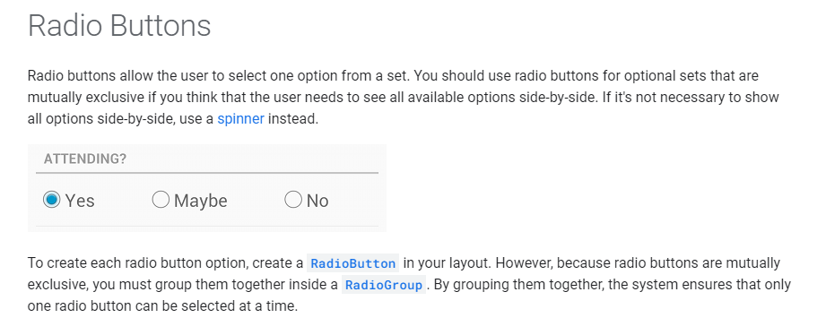
Basic Widgets
Radio Button:

Slide 72
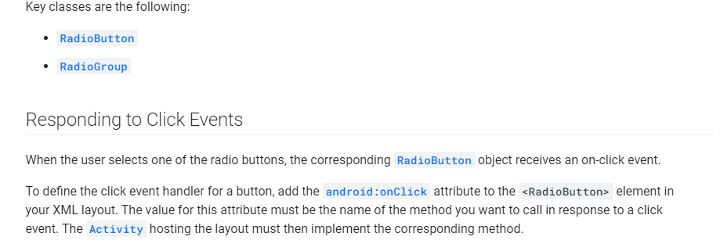
Basic Widgets
Radio Button:

Slide 73
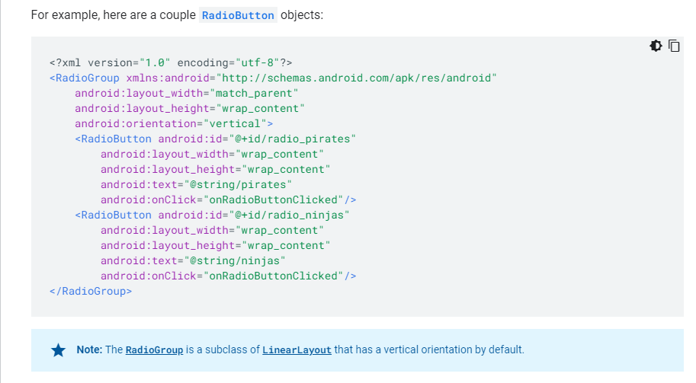
Basic Widgets
Radio Button:

Slide 74

Basic Widgets
Radio Button:

Slide 75
Basic Widgets
Radio Button:

Slide 76

Basic Widgets
Radio Button:

Slide 77

Basic Widgets
Radio Group:

Slide 78

Basic Widgets
Radio Group:

Slide 79

Basic Widgets
Radio Group:

Slide 80

Basic Widgets
Radio Group:

Slide 81

Basic Widgets
Radio Group:

Slide 82

Basic Widgets
Radio Group:

Slide 83

Basic Widgets
Radio Group:

Slide 84

Basic Widgets
Check Box:

Slide 85

Basic Widgets
Check Box:

Slide 86

Basic Widgets
Check Box:

Slide 87

Basic Widgets
Check Box:

Slide 88

Basic Widgets
Progress Bar:

Slide 89

Basic Widgets
Progress Bar:

Slide 90

Basic Widgets
Progress Bar:

Slide 91

Basic Widgets
Progress Bar:

Slide 92

Basic Widgets
Progress Bar:

Slide 93

Basic Widgets
Spinner :

Slide 94

Basic Widgets
Spinner :

Slide 95

Basic Widgets
Spinner :

Slide 96

Basic Widgets
Spinner :

Slide 97

Basic Widgets
Spinner :

Slide 98

Basic Widgets
Spinner :

Slide 99

Basic Widgets
Spinner :

Slide 100
ListView

Slide 101
ListView
What is List view
How to Implement the ListView.

Slide 102


ListView

Slide 103
ListView
What is List view?
ListView is a very common UI element in Android Applications. It is used to display a list of items separated by dividers that can be scrolled endlessly. It’s generally used to display a group of related items.
A list view is an adapter view that does not know the details, such as type and contents, of the views it contains. Instead list view requests views on demand from a ListAdapter as needed, such as to display new views as the user scrolls up or down.

Slide 104
ListView
To implement a ListView we have to create the following:
of course the ListView itself which we should add to our screen layout.
a layout for each row in the list.
an adapter which holds the data and bind them to the list.

Slide 105

Adapters: Servants of the ListView
What Exactly is an Adapter?

Slide 106
ListView
How to Implement it:
ListView XML Layout
<ListView
android:id="@+id/recipe_list_view"
android:layout_width="match_parent"
android:layout_height="wrap_content />

Slide 107
List View XML attributes
android:divider : Drawable or color to draw between list items.
android:dividerHeight : Height of the divider.
android:entries : An array resource can be passed here to be displayed as a List.
android:footerDividersEnabled : When set to false, there will be no divider at the end of the ListView.
android:headerDividersEnabled : When set to false, there will be no divider at the top of the ListView.
android:clickable: This makes the ListView rows clickable.
android:listSelector: Set the background color of the list view row when it is clicked.

Slide 108
String.xml
<string-array name="Colors">
<item name="color">Red</item>
<item name="color">Orange</item>
<item name="color">Yellow</item>
<item name="color">Green</item>
<item name="color">Blue</item>
<item name="color">White</item>
<item name="color">Black</item>
<item name="color">Purple</item>
<item name="color">Pink</item>
<item name="color">Gray</item>
<item name="color">Cyan Blue</item>
<item name="color">Magenta</item>
</string-array>

Slide 109
Activity_main.xml
<?xml version="1.0" encoding="utf-8"?>
<android.support.constraint.ConstraintLayout xmlns:android="http://schemas.android.com/apk/res/android"
xmlns:app="http://schemas.android.com/apk/res-auto"
xmlns:tools="http://schemas.android.com/tools"
android:layout_width="match_parent"
android:layout_height="match_parent"
tools:context=".MainActivity">
<ListView
android:layout_width="wrap_content"
android:layout_height="wrap_content"
android:entries="@array/Colors"
app:layout_constraintBottom_toBottomOf="parent"
app:layout_constraintLeft_toLeftOf="parent"
app:layout_constraintRight_toRightOf="parent"
app:layout_constraintTop_toTopOf="parent" />
</android.support.constraint.ConstraintLayout>

Slide 110
ListView Adapter
A ListView class by itself cannot populate the entries. An Adapter is responsible for populating the data in the ListView. We have built-in adapter classes(like the one above) which come with a built-in layout for each row
getView() : We can inflate our own layouts in the Adapter inside this method.
notifyDataSetChanged() method on the adapter is called if the data has changed or if new data is available.

Slide 111
Types of ListView Adapters
There are four main types of Adapters:
1.BaseAdapter – As the name suggests this abstract is extended by all the other adapters. When creating a custom adapter using this as the parent class, you need to override all the methods mentioned above along with getCount(), getId() etc.
2.ArrayAdapter – This populates the ListView with the array supplied. It is defined as:
var arrayAdapter = ArrayAdapter<String>(context,layout,array);

Slide 112
Types of ListView Adapters
3.ListAdapter – Unlike an ArrayAdapter, this is an interface. So it can be used only with concrete adapter classes. Concrete Adapter classes are ListActivity and ListFragment.
4.SimpleCursorAdapter – This is used when the data needs to populated from a Database. In its constructor, we must specify the layout for each row and also the Cursor instance which contains the fields that need to be displayed.

Slide 113
ListView
How to Implement it:
Class MainActivity : AppCompatActivity() {
override fun onCreate(savedInstanceState: Bundle?) {
super.onCreate(savedInstanceState)
setContentView(R.layout.activity_main)
// use arrayadapter and define an array
val arrayAdapter: ArrayAdapter<*>
val users = arrayOf( "Virat Kohli", "Rohit Sharma", "Steve Smith",
"Kane Williamson", "Ross Taylor" )

Slide 114

ListView

Slide 115
ListView
listView.setOnItemClickListener(){adapterView, view, p, id ->
val itemAtPos = adapterView.getItemAtPosition(p)
val itemIdAtPos = adapterView.getItemIdAtPosition(p)
Toast.makeText(Context,Variable name that contain name, Toast.LENGTH_LONG).show()
}

Slide 116
ListView Custom Adapter-ArrayAdapter
class ContactAdapter(context: Context, contacts: Array<Contact>) : ArrayAdapter<Contact>(context, 0, contacts) { override fun getView(position: Int, convertView: View?, parent: ViewGroup): View { var listItemView = convertView if (listItemView == null) { listItemView = LayoutInflater.from(context).inflate(R.layout.single_contact_item, parent, false) } // Get the Contact object for this position val currentContact = getItem(position) // Find the TextViews in the single_contact_item.xml layout val nameTextView = listItemView!!.findViewById<TextView>(R.id.text_name) val phoneTextView = listItemView.findViewById<TextView>(R.id.text_mobile_no) // Set the text of TextViews with data from the current Contact nameTextView.text = currentContact?.name phoneTextView.text = currentContact?.phoneNumber return listItemView } }

Slide 117
ListView Custom Adapter-BaseAdapter
class ContactAdapter(val context: Context,val contacts: Array<Contact>):BaseAdapter(){ override fun getCount(): Int { return contacts.size } override fun getItem(position: Int): Any { return contacts[position] } override fun getItemId(position: Int): Long { return contacts[position].id.toLong() } override fun getView(position: Int, convertView: View?, parent: ViewGroup?): View { var listItemView = convertView if (listItemView == null) { listItemView = LayoutInflater.from(context).inflate(R.layout.single_contact_item, parent, false) } // Get the Contact object for this position val currentContact = getItem(position) as Contact // Find the TextViews in the single_contact_item.xml layout val nameTextView = listItemView!!.findViewById<TextView>(R.id.text_name) val phoneTextView = listItemView.findViewById<TextView>(R.id.text_mobile_no) // Set the text of TextViews with data from the current Contact nameTextView.text = currentContact.first_name +" "+currentContact.last_name phoneTextView.text = currentContact.phone return listItemView } }

Slide 118
RecyclerView
As we know RecyclerView is more advanced and efficient version of ListView. Using RecyclerView, we can display and maintained large number of data using limited number of views.

Slide 119
RecyclerView in activity_main.xml
<androidx.recyclerview.widget.RecyclerView android:id="@+id/listView1" android:layout_width="match_parent" android:layout_height="match_parent" app:layoutManager="androidx.recyclerview.widget.LinearLayoutManager" tools:itemCount="5" tools:listitem="@layout/person_item_view" />

Slide 120
RecyclerView in person_item.xml
<TextView android:id="@+id/textView_name" android:layout_width="match_parent" android:layout_height="wrap_content" android:textSize="18sp" android:textStyle="bold" android:text="Guerra Rodgers"/> <TextView android:id="@+id/textView_phone_no" android:layout_width="match_parent" android:layout_height="wrap_content" android:text="+919289635723" /> <TextView android:id="@+id/textView_email" android:layout_width="match_parent" android:layout_height="wrap_content" android:text="guerra_rodgers@gnu.ac.in" /> <TextView android:id="@+id/textView_address" android:layout_width="match_parent" android:layout_height="wrap_content" android:text="88 College Place, Umapine, Oregon" />

Slide 121
RecyclerView Layout Manager
We can manage/create RecyclerView behaviours using LayoutMangers. RecyclerView uses pre built LayoutMangers and Implements different behaviours such as :
Vertical/Horizontal List(Using LinearLayoutManger)
Uniform Grid List (Using GridLayoutManager)
Staggered Grid List (Using StaggeredGridLayoutManager)
LayoutManger Helps us in :
Orientation of the List (Vertical orHorizontal).
Manages positions of the items.
Defines type of list i.e List, Gird or staggered.
Calculates position and size of items of individual items in the RecyclerView.

Slide 122


RecyclerView Layout Manager
Horizontal LinearLayoutManager
Vertical LinearLayoutManager

Slide 123


RecyclerView Layout Manager
GridLayoutManager
StaggeredGridLayoutManager

Slide 124
RecyclerView Adapter
class PersonAdapter (private val context: MainActivity, private val array:ArrayList<Person>): RecyclerView.Adapter<PersonAdapter.PersonViewHolder>() { inner class PersonViewHolder(val bindingView: View): RecyclerView.ViewHolder(bindingView) override fun onCreateViewHolder(parent: ViewGroup, viewType: Int): PersonViewHolder { val bindingView = LayoutInflater.from(parent.context).inflate(R.layout.person_item_view,parent,false) return PersonViewHolder(bindingView) } override fun onBindViewHolder(holder: PersonViewHolder, position: Int) { with(holder){ with(array[position]){ bindingView.findViewById<TextView>(R.id.textView_phone_no).text = this.phoneNo bindingView.findViewById<TextView>(R.id.textView_name).text = this.name bindingView.findViewById<TextView>(R.id.textView_email).text = this.emailId bindingView.findViewById<TextView>(R.id.textView_address).text = this.address } } } override fun getItemCount(): Int { return array.size } }

Slide 125
Grid View
What is Grid View
How to Implement the Grid view.

Slide 126
Grid View
What is Grid View
How to Implement the Grid view.

Slide 127


Grid View
What is Grid View
How to Implement the Grid view.

Slide 128
Grid View
What is Grid View
Android GridView shows items in two-dimensional scrolling grid (rows & columns) and the grid items are not necessarily predetermined but they automatically inserted to the layout using a ListAdapter

Slide 129
Grid View
What is Grid View
Android GridView shows items in two-dimensional scrolling grid (rows & columns) and the grid items are not necessarily predetermined but they automatically inserted to the layout using a ListAdapter

Slide 130

Grid View Attributes

Slide 131

Grid View Attributes

Slide 132
Alert DialogBox
fun showAlertDialog(context: Context, title: String, message: String, positiveButtonTitle: String, negativeButtonTitle: String, onPositiveButtonClick: () -> Unit, onNegativeButtonClick: () -> Unit ) { AlertDialog.Builder(context) .setTitle(title) .setMessage(message) .setPositiveButton(positiveButtonTitle) { dialog, _ -> onPositiveButtonClick() dialog.dismiss() } .setNegativeButton(negativeButtonTitle) { dialog, _ -> onNegativeButtonClick() dialog.dismiss() } .setCancelable(false) // To prevent the user from dismissing the dialog by tapping outside .show() }

Slide 133
Alert DialogBox
showAlertDialog( context = this, // Replace 'this' with your Activity or Context title = "Confirmation", message = "Do you want to continue?", positiveButtonTitle = "Yes", negativeButtonTitle = "No", onPositiveButtonClick = { // Handle the positive button click // You can put your code here }, onNegativeButtonClick = { // Handle the negative button click // You can put your code here } )

Slide 134
Custom DialogBox

Slide 135

note_edit_view.xml

Slide 136

note_edit_view.xml

Slide 137

note_edit_view.xml

Slide 138

note_edit_view.xml

Slide 139
Custom Dialogbox
val builder: AlertDialog.Builder = AlertDialog.Builder(context) builder.setTitle(dialogTitle) // set the custom layout val customLayout: View = LayoutInflater.from(context).inflate(R.layout.note_edit_layout, null) customLayout.findViewById<TextInputEditText>(R.id.note_title).setText(note.title) customLayout.findViewById<TextInputEditText>(R.id.note_subTitle).setText(note.subTitle) customLayout.findViewById<TextInputEditText>(R.id.note_description) .setText(note.Description) val reminderSwitch = customLayout.findViewById<SwitchMaterial>(R.id.reminderSwitch) val timePicker = customLayout.findViewById<TimePicker>(R.id.reminderTime) reminderSwitch.isChecked = note.isReminder timePicker.hour = note.getHour() timePicker.minute = note.getMinute() builder.setView(customLayout) builder.setPositiveButton( "Save", DialogInterface.OnClickListener { dialog, which -> }) // create and show the alert dialog val dialog: AlertDialog = builder.create() dialog.show() }

